Slide 1

Agile Software Development
SDLC - Cross-functional Teams – Roles and Responsibilities
SoftUni Team
Technical Trainers
Software University
http://softuni.bg

Slide 2
Table of Contents
Homework Questions
Software Development Life Cycle (SDLC)
Agile SDLC
Building Cross-functional teams
Roles and Responsibilities

Slide 3
Have a Question?
sli.do #Agile-2021

Slide 4
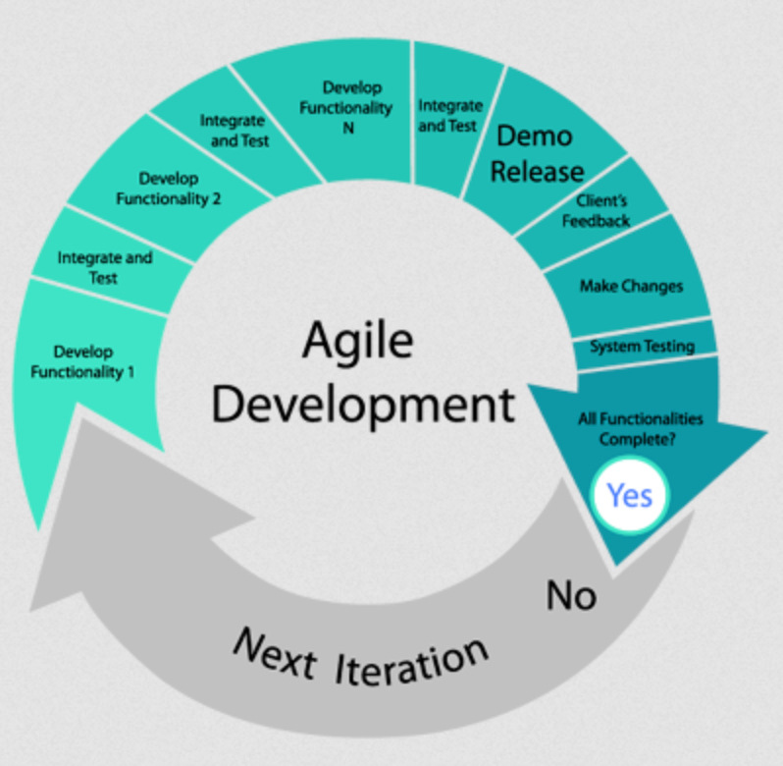
Refresher
“The core focus of Agile project management should be on people, prototypes, collaboration, and iteration”

Slide 5

Homework Questions?

Slide 6

Software Development Life Cycle (SDLC)

Slide 7
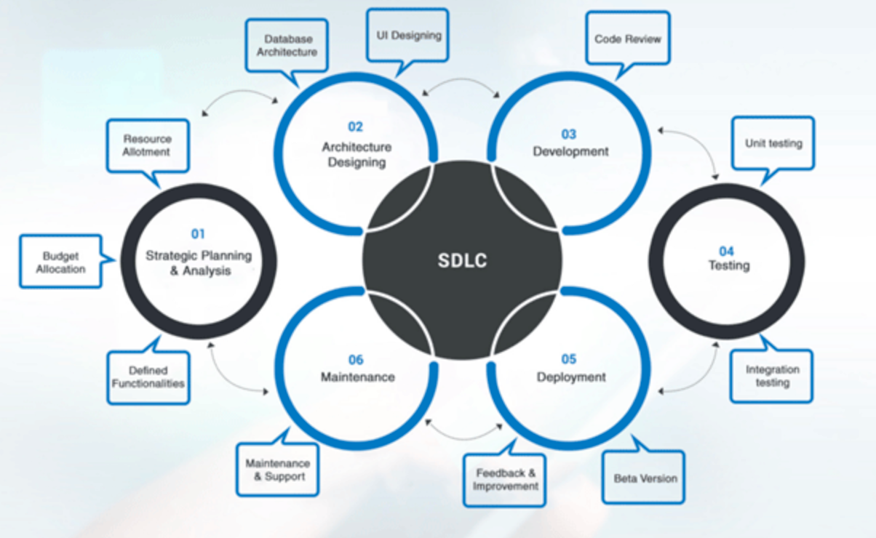
Software Development Life Cycle
The process of planning, creating, testing and deploying a software is called Software Development Life Cycle or SDLC.

Slide 8
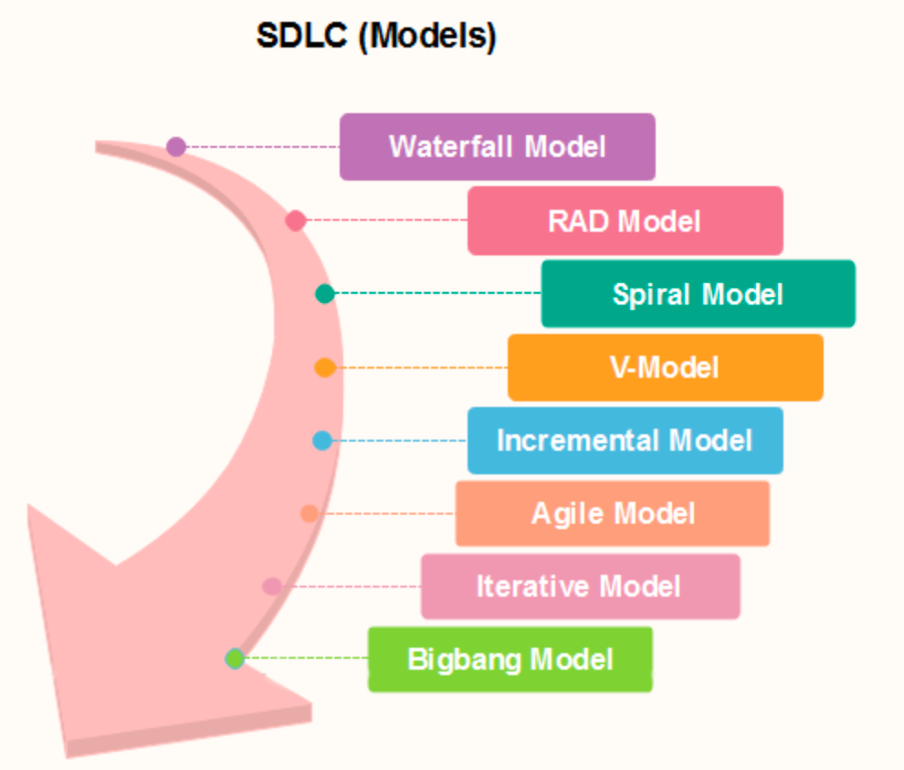
SDLC models
Waterfall
RAD Model
Spiral
V-shaped
Incremental
Agile
Iterative
Big bang

Slide 9
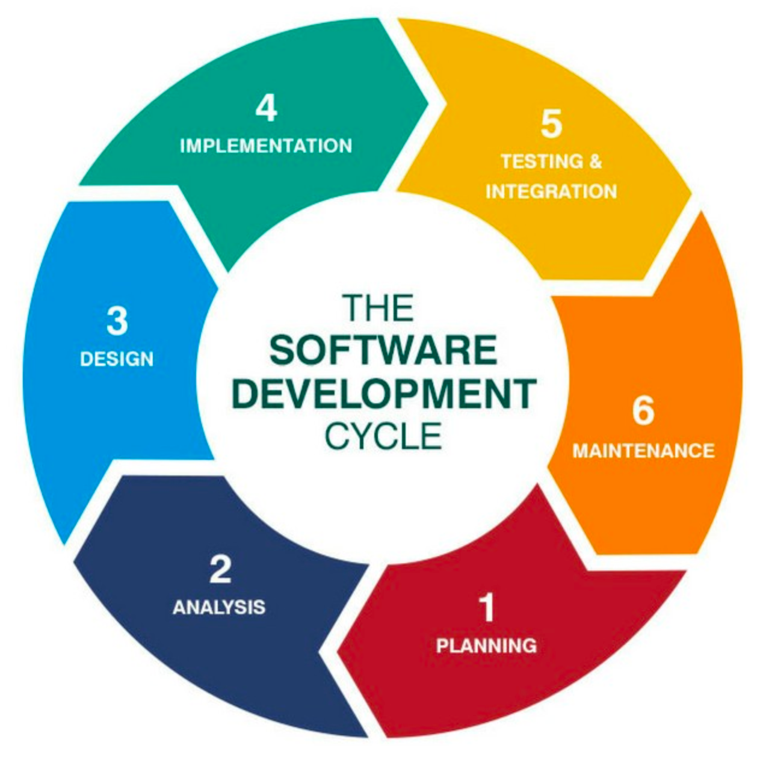
SDLC Phases
Planning and Requirements Gathering
Analysis
Design
Implementation
Testing & Integration
Deployment & Maintenance Phase

Slide 10
SDLC - Planning & Requirements
Gathering business requirements
Main focus of the project managers and stakeholders
Meetings with managers, stakeholders and users
General questions:
Who is going to use the software? How will they use the system?
What data should be input into the system?
What data should be output by the system?

Slide 11
SDLC - Analysis
Requirements analysis for validity and the possibility of incorporating the requirements in the system
Project timeline and scope
Functional and non-functional requirements of the project
Software requirement specification (SRS)
determines the overall cost
defines the functionalities which will be designed and developed during the project lifecycle.

Slide 12
SDLC - Design
System and software design is prepared from the requirement specifications
System Design
Specifying hardware and system requirement
Defining overall system architecture
System design specifications serve as input for the next phase of the model
Forming the Test Strategy

Slide 13
SDLC - Implementation
Producing software
Based on the system design documents, the work is divided in modules and actual coding is started
Main focus for the developers
The longest phase of the software development life cycle

Slide 14
SDLC – Testing and Integration
Execution of the Test Strategy
After the code is developed it is tested against the requirements to make sure that the product is actually solving the needs addressed and gathered during the requirements phase.
Functional testing
unit testing
integration testing
system testing
acceptance testing
non-functional testing

Slide 15
SDLC – Deployment & Maintenance
The Software is prepared for its release in the market
The software is only released once all the requested changes are implemented and tested for functionality
Running software
Regular checks for maintenance to ensure the smooth functioning of the software at the customers’ end
Software updates

Slide 16
SDLC models - Homework
Research all SDLC models and prepare a comparison.

Slide 17

Agile SDLC

Slide 18
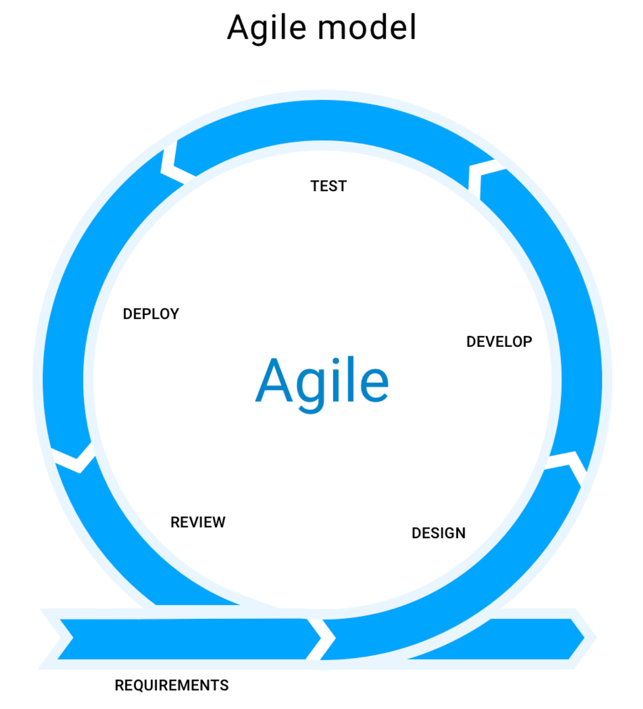
Agile SDLC
The Agile SDLC model is a combination of iterative and incremental process models with focus on process adaptability and customer satisfaction by rapid delivery of working software product. Agile methods break the product into small incremental builds. These builds are provided in iterations. Each iteration typically lasts from about one to four weeks. Every iteration involves cross- functional teams working simultaneously on the defined SDLC phases.

Slide 19
Agile SDLC – Requirements Phase
Before a Product Owner can even start designing a project, they need to create the initial documentation that will list the initial requirements. They are:
Defining the project goal to be achieved
The features that it will support
The features that it will not initially support

Slide 20
Agile SDLC – Design Phase
There are two ways to approach design in the software development — one is the visual design and the other is the architectural structure of the app:
Software Design
UI/UX Design

Slide 21
Agile SDLC – Development Phase
Writing code and converting design documentation into the actual software
This stage of SDLC is generally the longest as it is the backbone of the whole process

Slide 22
Agile SDLC – Integration and Testing Phase
Ensuring the software is bug-free and compatible with everything else that the developers have written before.
The Quality Assurance team conducts a series of tests in order to ensure the code is clean and business requirements of the solution are met

Slide 23
Agile SDLC – Deployment Phase
Deployment of the application on the servers provided to the customers:
User Acceptance Testing
Actual use
Further iterations update the already installed software, introducing new features and resolving bugs

Slide 24
Agile SDLC – Review Phase
Product Owner gathers the Development Team once again and reviews the progress made towards completing the requirements.
The team introduces their ideas toward resolving the problems that arose during the previous phases and the Product Owner takes their propositions into consideration
Afterwards, the Agile software development lifecycle phases starts a new iteration

Slide 25
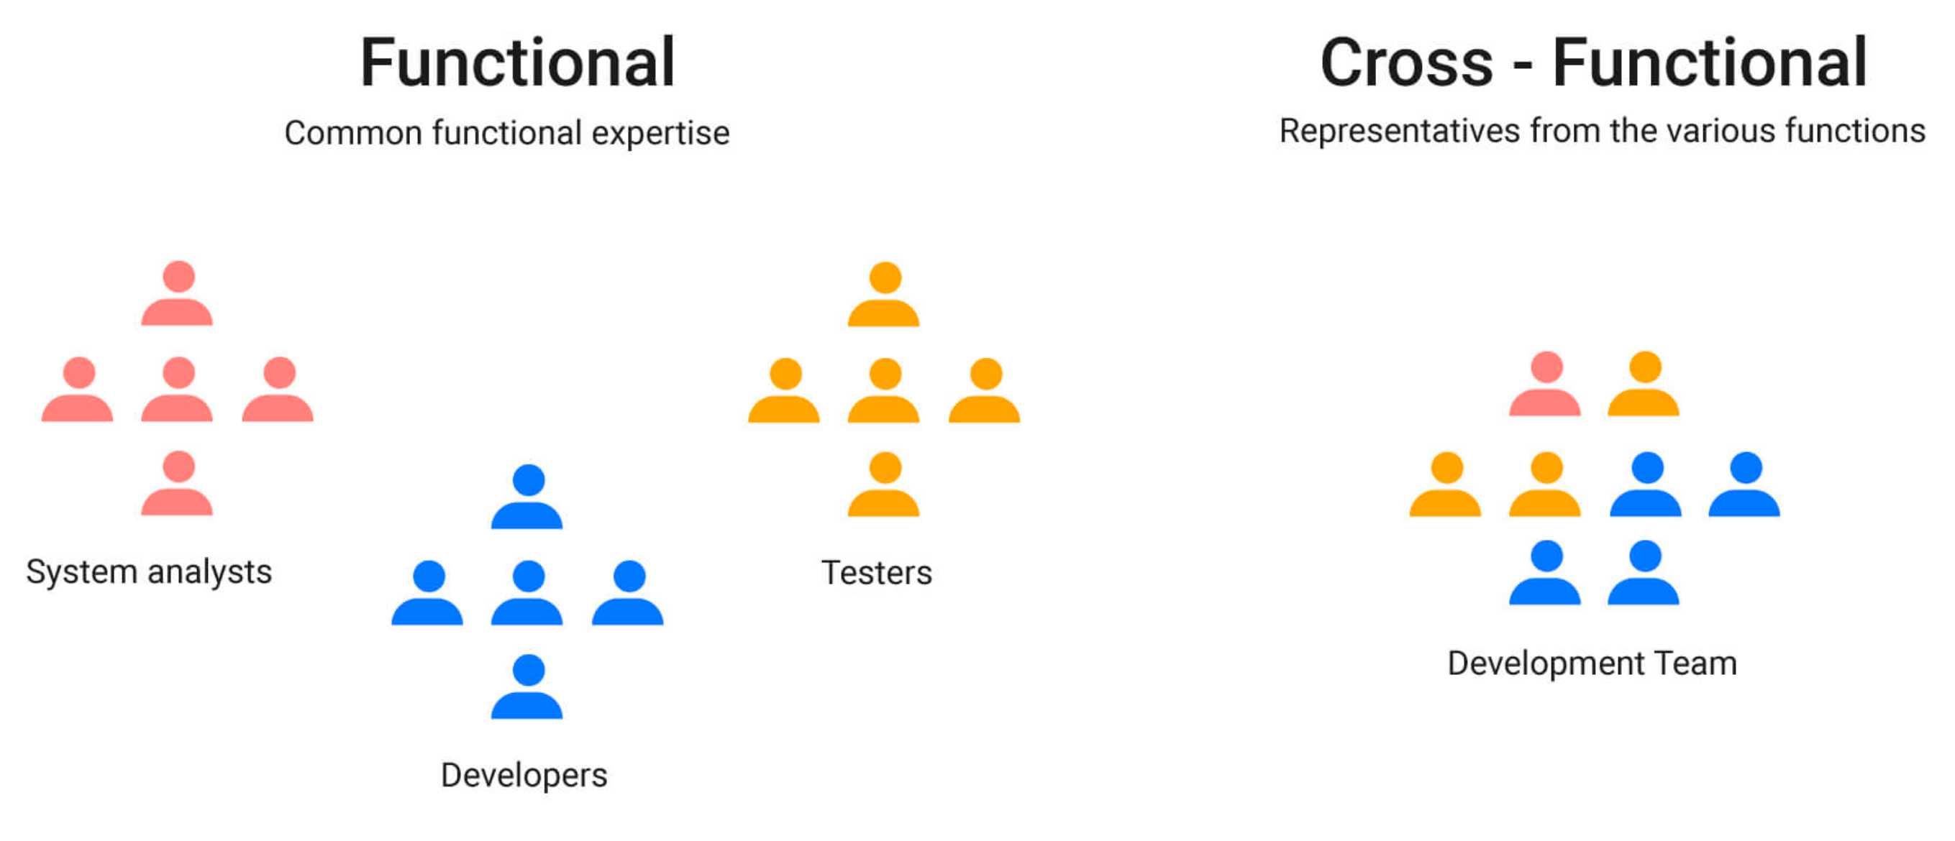
Cross-functional Team
A cross-functional team has access to all the skills necessary to effectively deliver value to customers
A cross-functional team does not have to consist of all generalists
A cross-functional team also does not have to consist of all specialists

Slide 26
Cross-functional Team
Benefits of a cross-functional team:
Getting to done
Self-organizing
Innovative
Increased flow

Slide 27
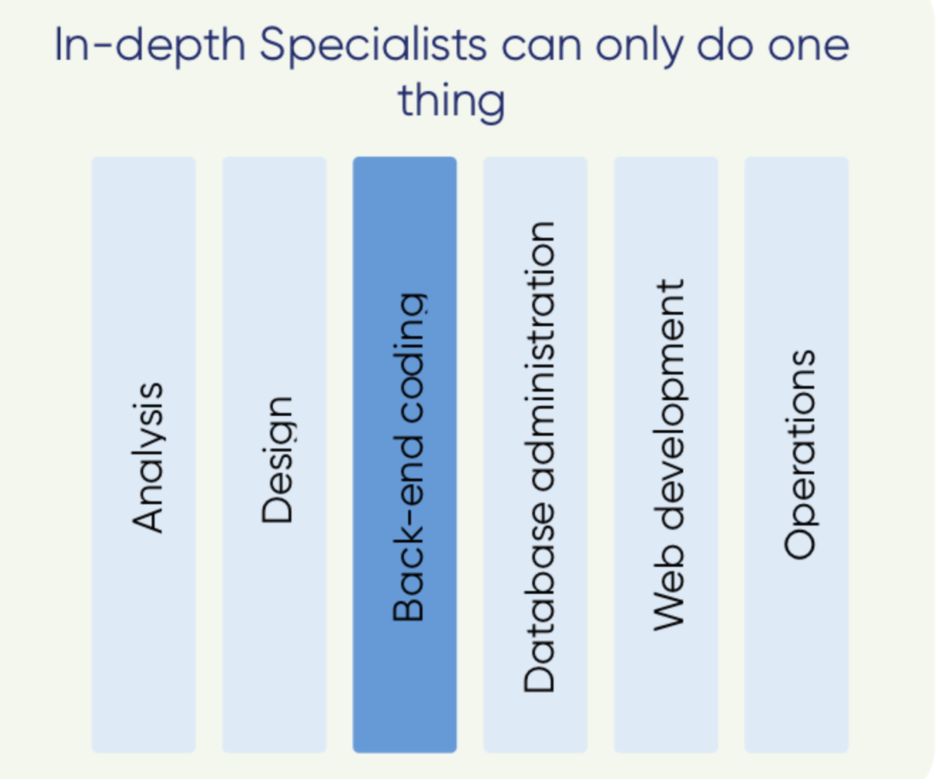
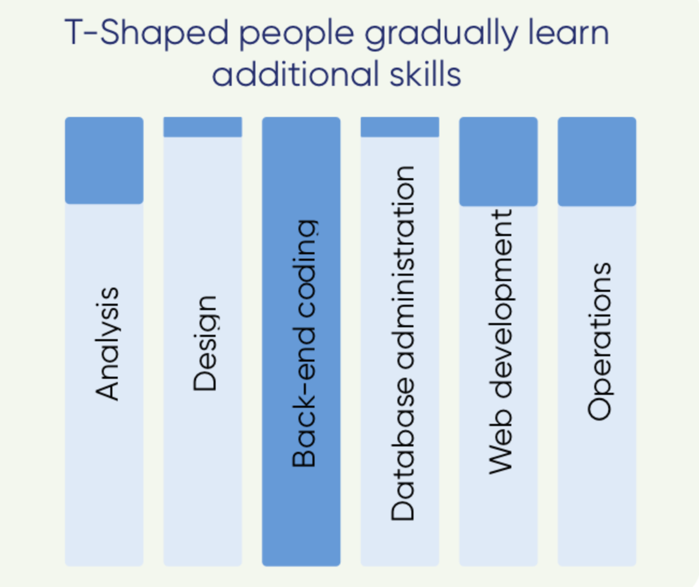
T-Shaped Team Members
People who develop skills outside of their chosen or preferred skillset, have become known as “T-shaped”
The vertical part of the T represents the depth of their main, preferred skill
The horizontal part of the T represents other skills used in order to collaborate and get the work of the team to ‘done’
Truly cross-functional team members will do whatever is required of them to get the work done

Slide 28
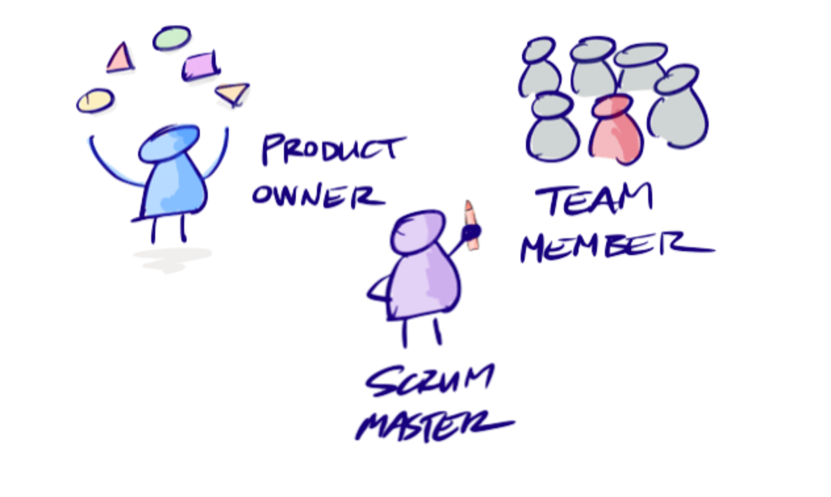
Agile Roles and Responsibilities
Agile team lead (ScrumMaster)
Product Owner
Development Team
Together all three roles make up an Agile Team

Slide 29
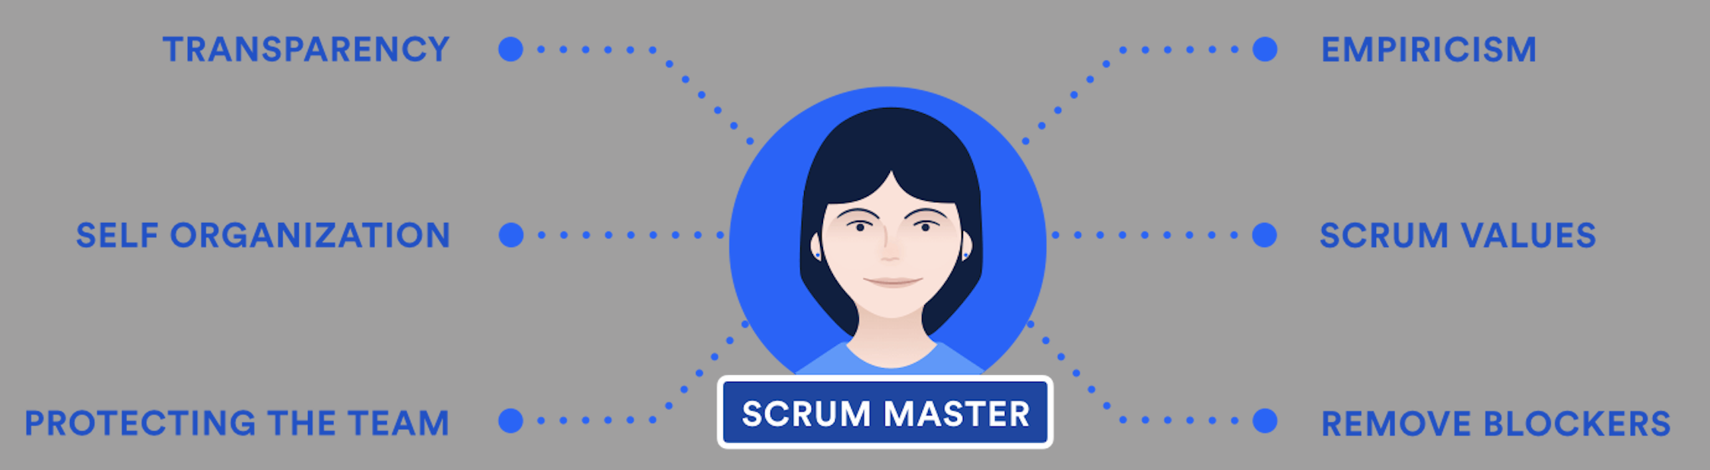
Agile Team Lead
Transparency
Empiricism
Self Organization
Agile Values

Slide 30
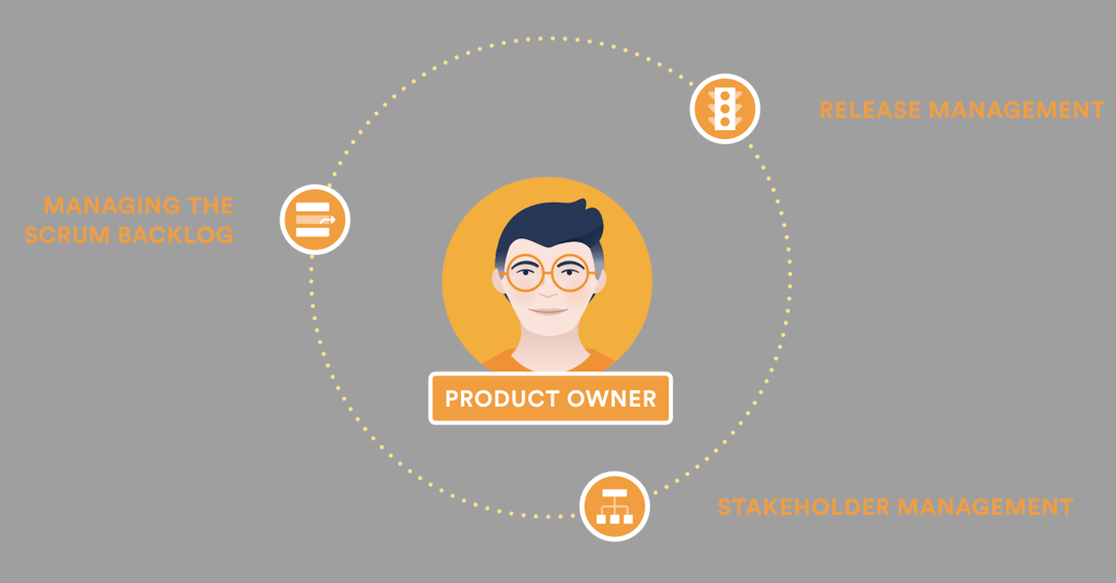
Product Owner
Managing the backlog
Release management
Stakeholder management

Slide 31
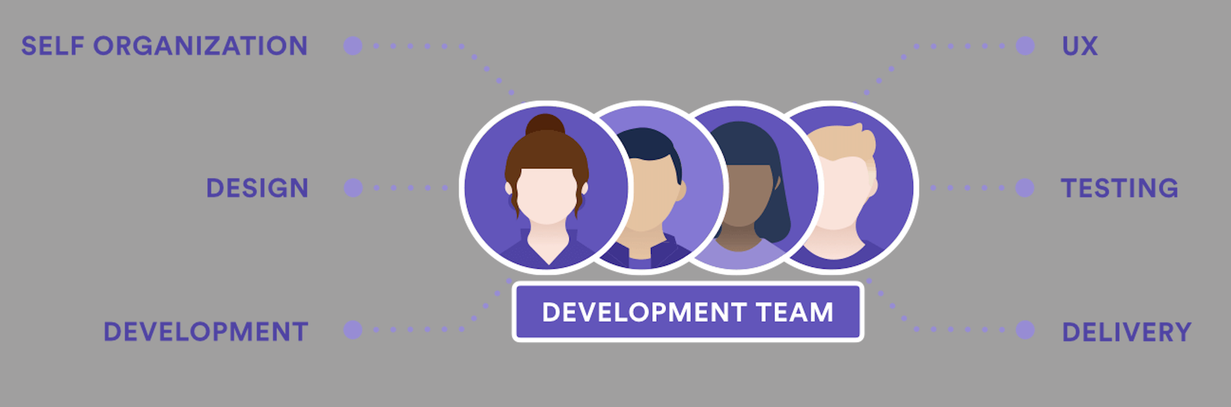
Development Team
The development team are the people that do the work
Does development team mean engineers?
Development team can be comprised of all kinds of people including designers, technical writers, programmers, etc.

Slide 32

Summary
SDLC
Agile SDLC
Cross-functional Teams
Roles and Responsibilities
…
…
…

Slide 34













SoftUni Diamond Partners

Slide 35

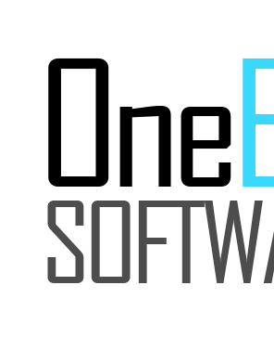


SoftUni Organizational Partners

Slide 36





Trainings @ Software University (SoftUni)
Software University – High-Quality Education, Profession and Job for Software Developers
softuni.bg
Software University Foundation
http://softuni.foundation/
Software University @ Facebook
facebook.com/SoftwareUniversity
Software University Forums
forum.softuni.bg

